Slide 1
Secure Data Hiding in Image Using Steganography
CAPSTONE PROJECT
Presented By : Aditi Yedge
Student Name : Aditi Yedge
College Name & Department : R J College , Ghatkopar, Computer Science

Slide 2
OUTLINE
Problem Statement
Technology used
Wow factor
End users
Result
Conclusion
Git-hub Link
Future scope

Slide 3
Problem Statement
In today's digital world, securing sensitive information is a major challenge. Traditional encryption techniques can attract attention, making it necessary to use hidden methods for data protection. Steganography provides a way to conceal data within images, ensuring privacy and security without drawing suspicion.

Slide 4
Technology used
Programming Language: Python
Libraries: OpenCV, os, string
Concepts Used: Least Significant Bit (LSB) Steganography

Slide 5
Wow factors
Hides secret messages inside images without noticeable distortion
Uses Least Significant Bit (LSB) manipulation for efficient encoding
Can be used for secure data transfer
Maintains image quality while embedding the secret message

Slide 6
End users
Cybersecurity Enthusiasts
Organizations requiring secure communication
Journalists & Whistleblowers
Researchers in Data Security

Slide 7
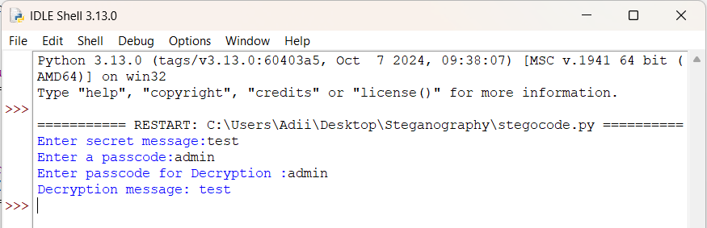
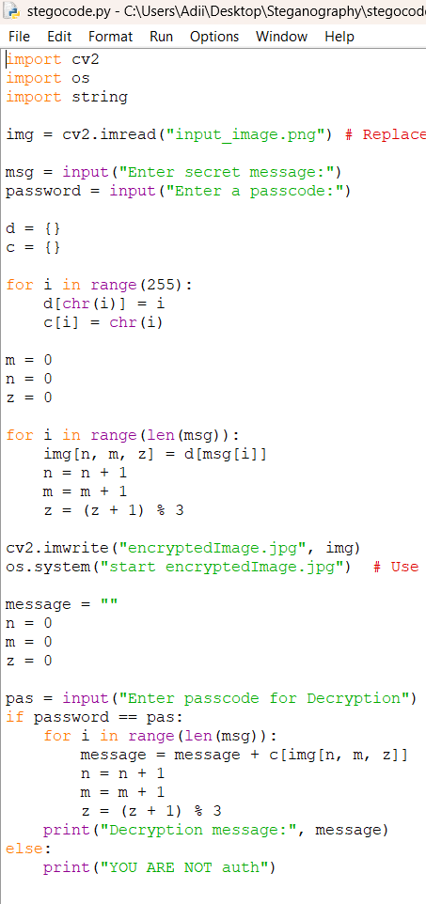
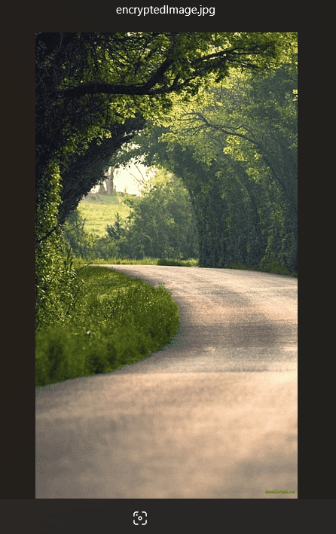
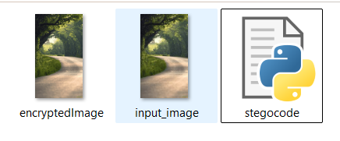
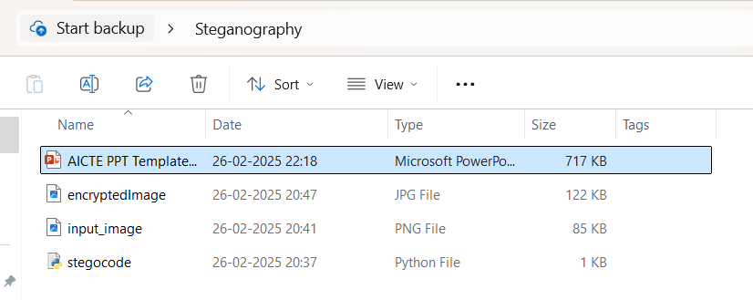
Results

Slide 8
Conclusion
This project successfully demonstrates how to securely hide and retrieve messages from an image using steganography. It provides a secure way to transmit sensitive information without raising suspicion, making it useful for secure communication and digital privacy enhancement.

Slide 9
GitHub Link
https://github.com/AditiYedge/steagnography/

Slide 10
Future scope(optional)
Implementation of more advanced steganographic techniques like DCT-based methods.
Enhancement with encryption before embedding for additional security.
Development of a user-friendly GUI for ease of use.

Slide 11
THANK YOU

